Slide 1
BETA STREAMFLOW DURATION ASSESSMENT METHOD (SDAM)
PRESENTED BY:
MATT MIKULECKY
REGULATORY TEAM LEADER
KANOPOLIS REGULATORY FIELD OFFICE

Slide 2
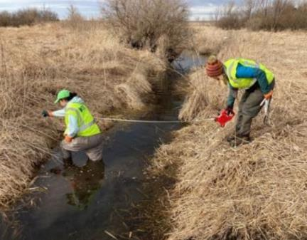
PRESENTATION OBJECTIVES
INTRODUCTION TO SDAM
PURPOSE
DATA COLLECTION INDICATORS
INTENDED USE
POTENTIAL APPLICATIONS

Slide 3
background
USEPA and USACE cooperative effort to develop a rapid assessment tool to help determine streamflow duration.
Six study regions have been established for SDAM development.
Final SDAM Pacific Northwest
Beta SDAM Arid West
Beta SDAM Western Mountains
Beta SDAM Great Plains
Under development – Northeast and Southeast (including Puerto Rico & U.S. Virgin Islands)
Under development – Alaska, Hawaii and Pacific Island U.S. Territories

Slide 4
Study regions & status

Slide 5
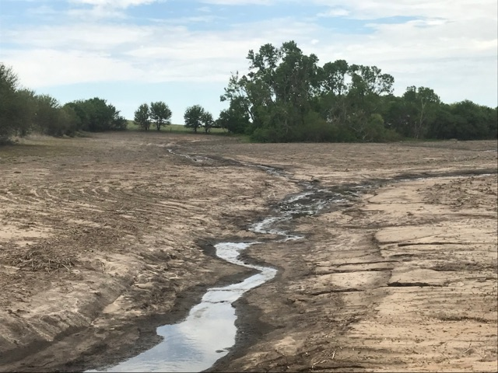
Sdam classifications
EPHEMERAL:
Channels that flow only in direct response to precipitation .
Water typically flows only during and/or shortly after large precipitation.
The streambed is always above the water table and stormwater runoff is the primary source.

Slide 6
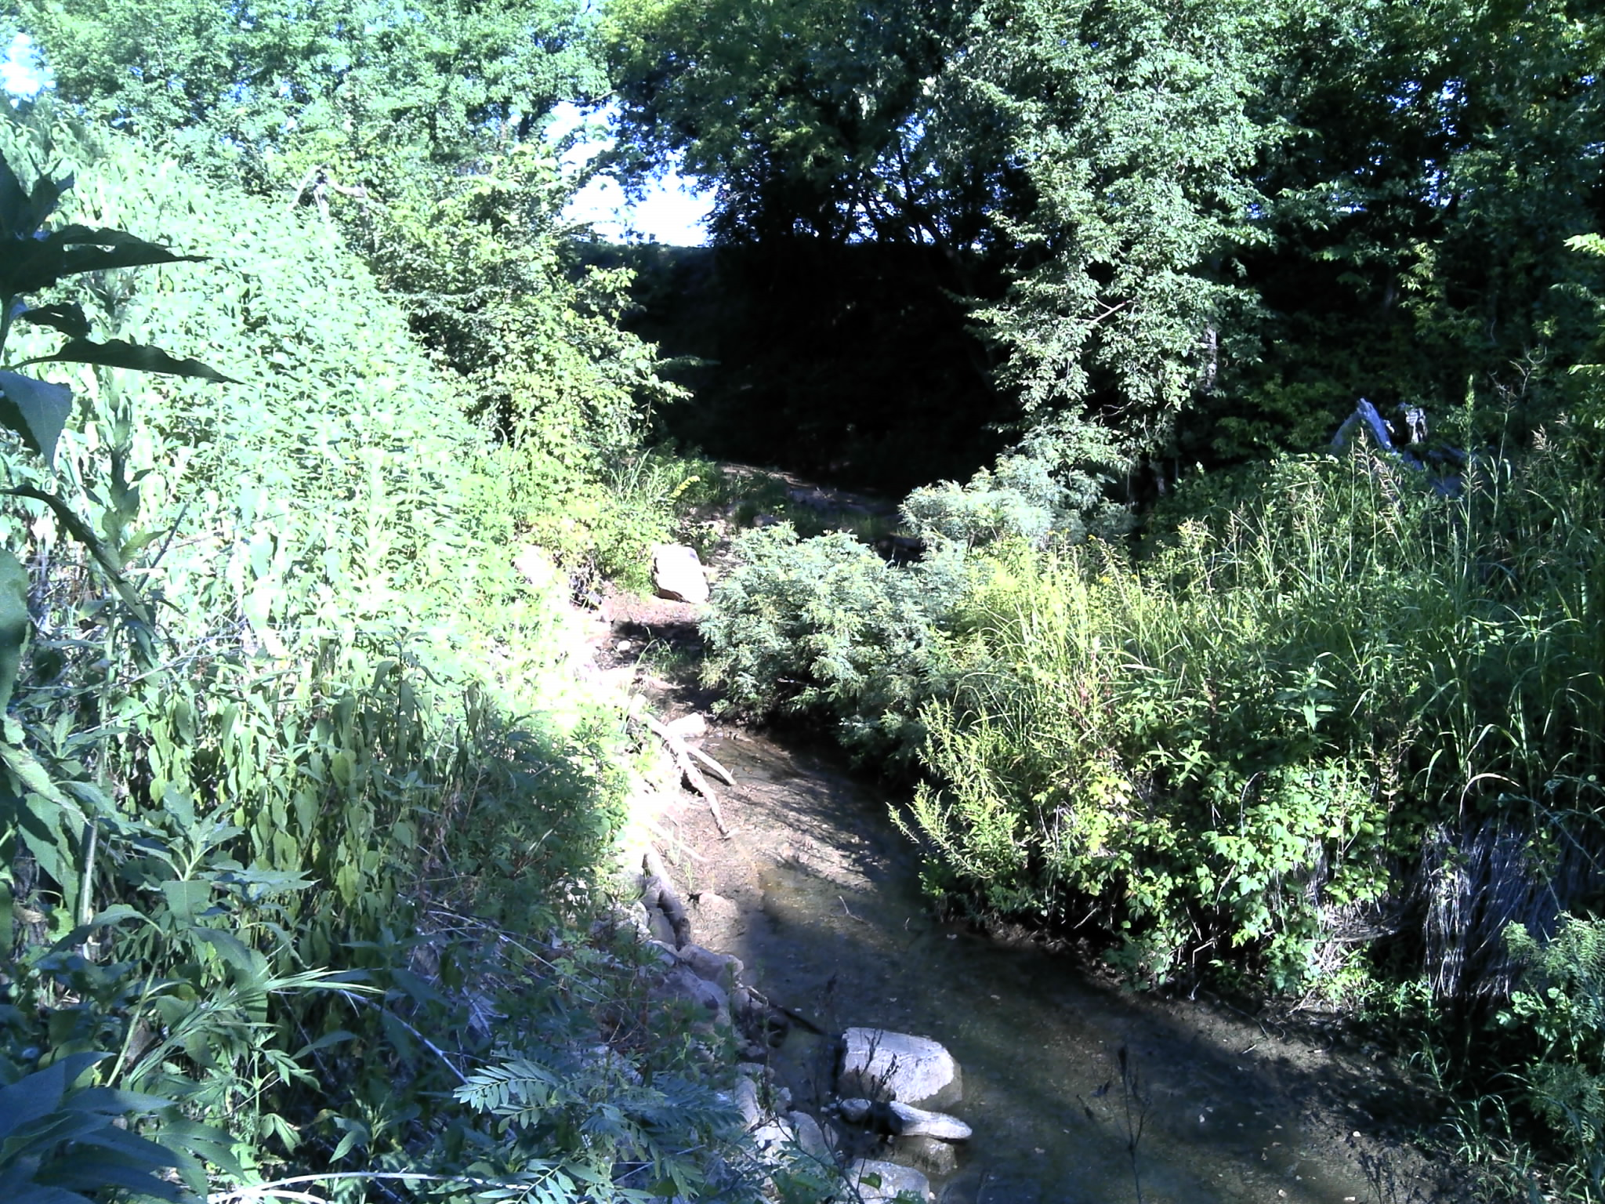
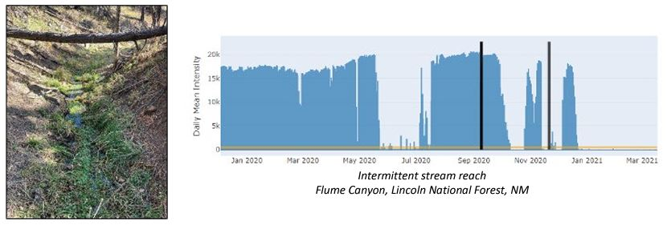
Sdam classifications
INTERMITTENT (and at-least intermittent):
Channels that contain sustained flowing water for only part of the year (typically during wet season).
Streambed may be below the water table.
Snowmelt from surrounding uplands provides sustained flow.
Flow may vary greatly with runoff.

Slide 7
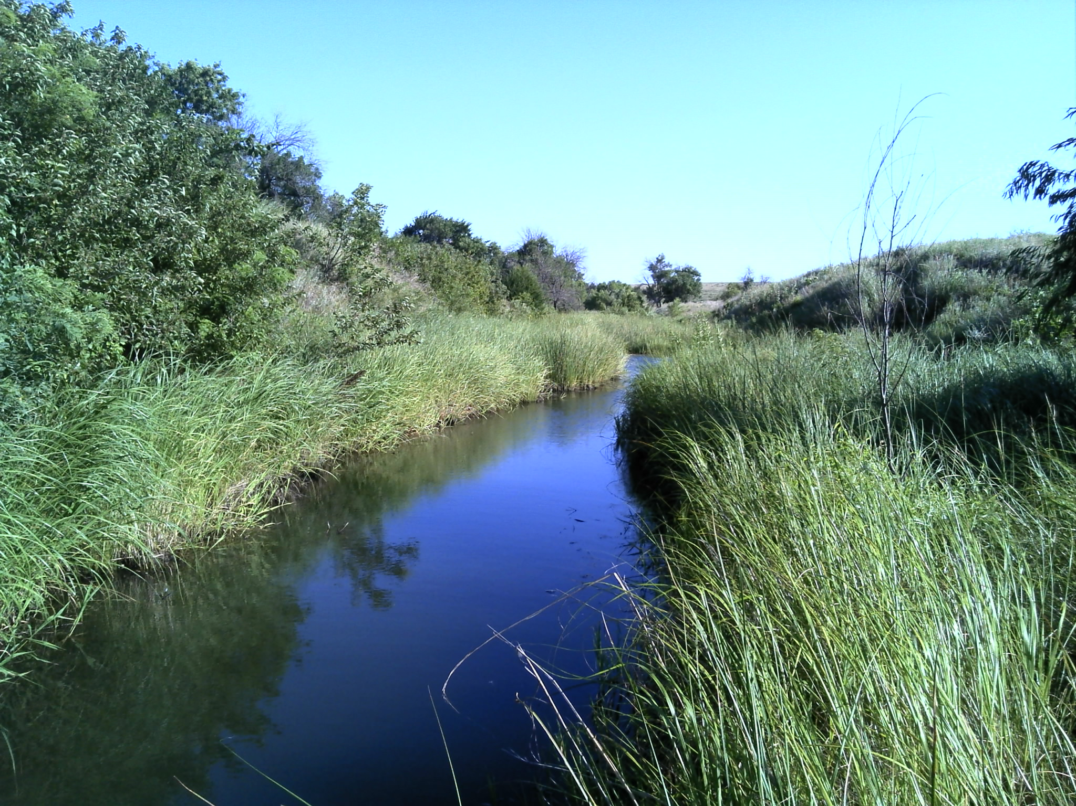
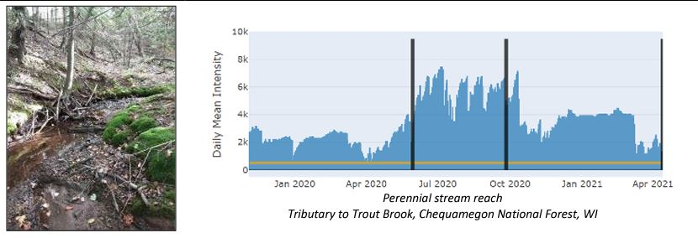
Sdam classifications
PERENNIAL:
Channels that contain flowing water continuously during a year of normal rainfall.
Streambed located below the water table for most of the year.
Groundwater typically supplies baseflow but may be supplemented by runoff/snow melt.

Slide 8
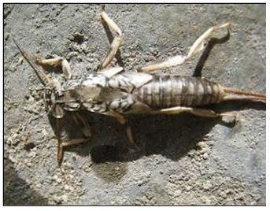
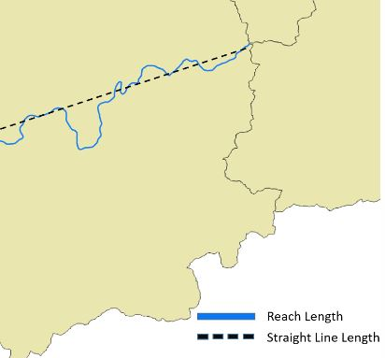
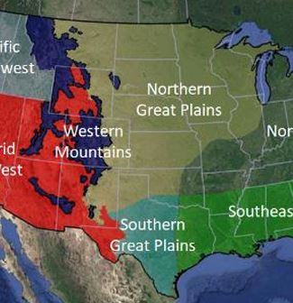
Sdam indicators
THREE OVER-ARCHING INDICATOR CATEGORIES
Biological
Geomorphological
Regional location
Biological Geomophological Regional location

Slide 9
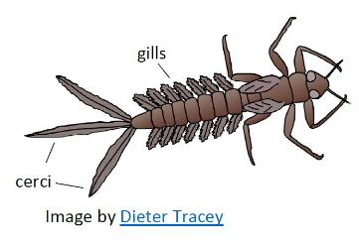
Nine indicators
BIOLOGICAL
Richness of mayflies, stoneflies and caddisflies
Percent shading
Number of hydrophytic plant species
Absence of rooted upland plants in streambed

Slide 10
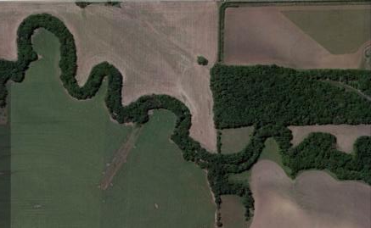
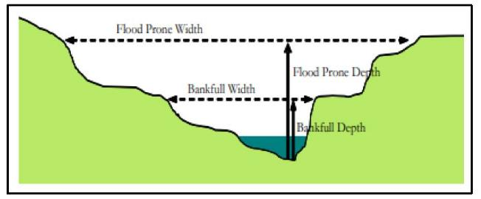
Nine indicators cont’d…
GEOMORPHOLOGICAL
Bankfull channel width
Sinuousity
Floodplain and channel dimensions
Particle size or stream substrate sorting

Slide 11
Nine indicators cont’d…
REGIONAL LOCATION INDICATOR
Northern or Southern Great Plains

Slide 12
Intended use & applications
Used to support field classifications of streamflow duration at the reach scale
Applications may include but not limited to:
Inform S404 Clean Water Act jurisdictional determinations
Inform S404 Clean Water Act permit applications and evaluations
Inform stream restoration, impacts and/or mitigation activities
Required field time approximately 2 hours

Slide 13
Scale of assessment
Assessment reach scale = minimum 40 meters and maximum 200 meters
Determine reach by multiplying average bankfull width by 40
Example: 2m x 40m = 80m assessment reach

Slide 14
Data collection
Desktop reconnaissance
Onsite data collection using SDAM Field Form
Walk assessment reach and take bankfull width measurements
Collect percent shading data at 4 locations
Begin sketch of assessment reach on Field Form

Slide 15
Data collection cont’d…
Evaluate other indicators
Macroinvertebrates
Assess channel and floodplain dimension
Substrate assessment
Record hydrophytic vegetation
Assess upland plants growing in the channel
Assess channel sinuosity
Complete sketch of assessment reach
Enter data into online web application to generate a streamflow duration classification

Slide 16
Data collection tools
Field notebook
Field Forms
Maps & aerial photographs
GPS
Tape measure
Pocket rod or leveling rod/meter stick
Kick-net, small net and tray
Hand lens
Digital camera / smartphone
Shovel, soil auger, rock hammer
Sand gauge card
Densiometer
Field guides (plants and macroinvertebrates)

Slide 17
Field form

Slide 18
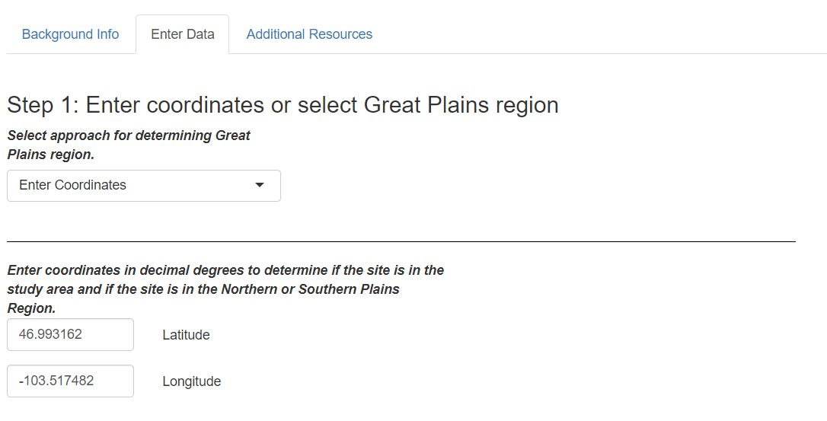
Online web application
Link:
SDAM Great Plains (shinyapps.io)

Slide 19
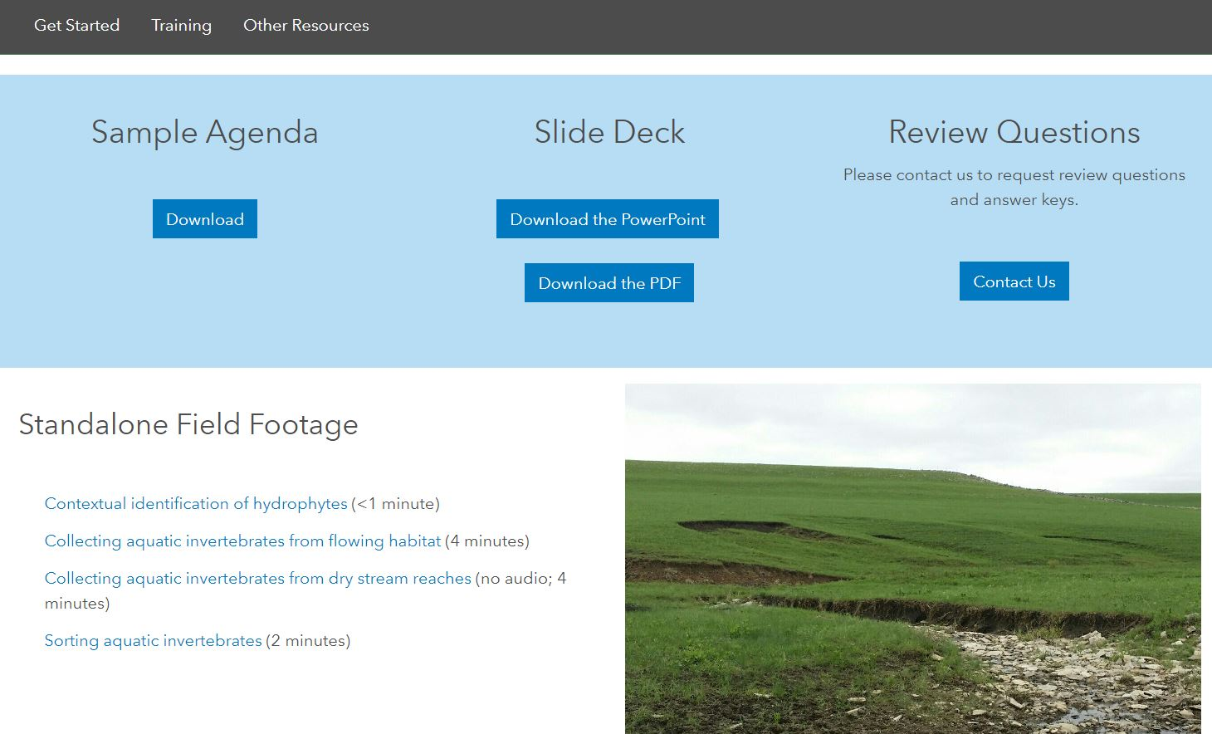
Sdam links & contact
Beta Streamflow Duration Assessment Method for the Great Plains | US EPA
SDAM for Great Plains (arcgis.com)
Point-of-contact in Kansas City District: Matt Mikulecky, 816-389-3027
E-mail: matthew.j.Mikulecky@usace.army.mil

Slide 20
questions

