Slide 1
THE KANSAS DEPARTMENT OF AGRICULTURE
Division of Conservation
January 31, 2023

Slide 2
Watershed Dam Construction Program
The State Cost-Share Assistance: KAR 11-3-4
Up to 80% of the construction cost:
Capped $120,000
Up to 70% of the actual construction
Up to 10% of the actual construction for engineering

Slide 3
Watershed Dam Construction Program - Restoration
KAR 11-3-1 Definition
Rehabilitation means any work, except work required to inadequate operation and maintenance, to extend the service life of the dam and to meet the applicable safety and performance standards.
Repair costs are a burden on most Districts
SFY2024 Governor’s Budget - $650,000

Slide 4
Watershed Dam Construction Program - Restoration

Slide 5
REMINDERS
State Cost-Share Applications, to be included in the evaluation process for next fiscal year:
New Constructions are due on or before April 1st
Rehab on or before July 1st.
District Meeting Minutes are due within 2 weeks from the date of the meeting.
O&M Inspections for all Districts Structures are due on or before December 31. O&M Workshop?

Slide 6
REMINDERS (cont.)
Water Use Reports are due on or before March 1^{st of} every year:
Jan 1 to March 1 No Penalty
March 2 to June 1 $250 per file
After June 2 $1,000 per file
Any questions about your Water Use Reports
Call or email DWR or DWR Field Office

Slide 7
2022 Challenges
KANSAS STREAM MITIGATION METHOD (KSMM) Version 4 May 2022
No major changes
PL 566 Funding in BIL and IRA
Details are not fully known
Only eligible if originally funded by PL 556 – Clarify in Farm Bill
State Cost-Share not eligible if PL 556 eligible
WOTUS Definition – December 2022
Pre-2015 Definition – Ephemeral Streams are Jurisdictional

Slide 8
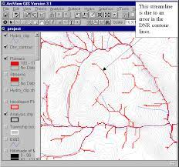
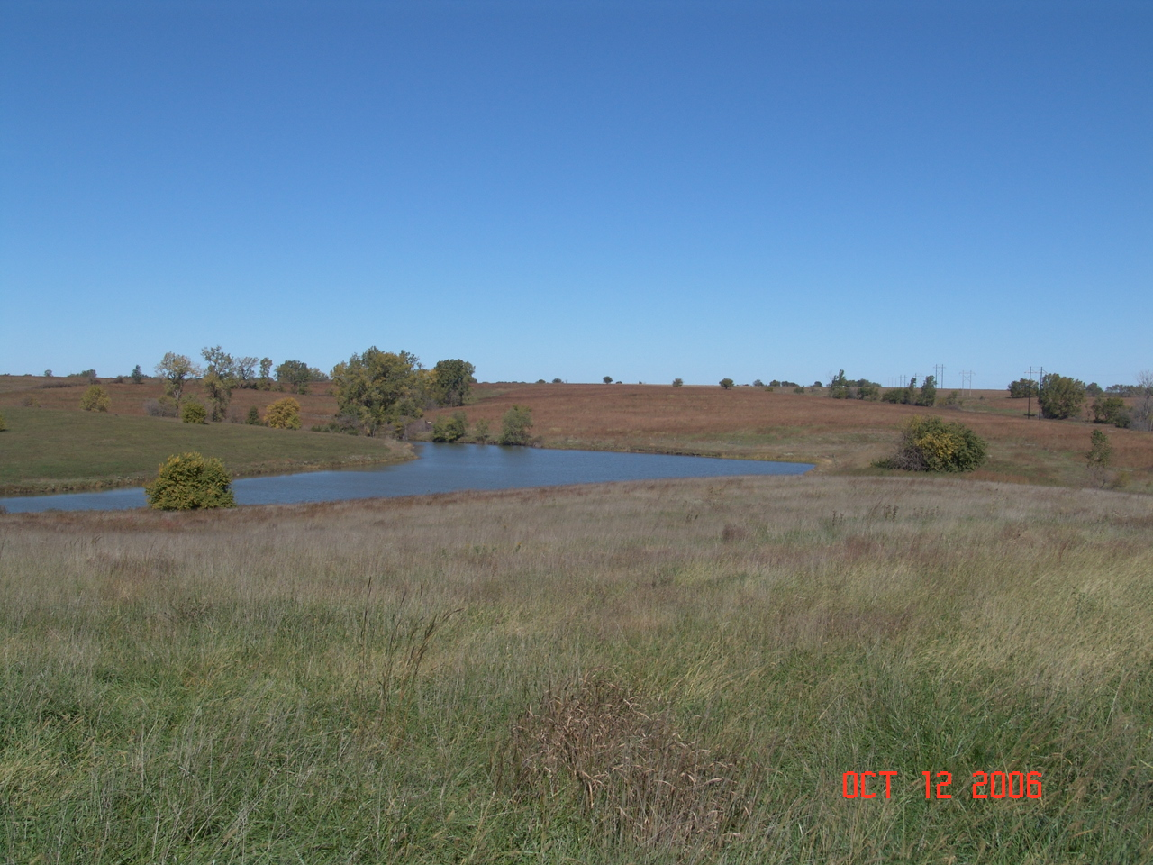
GIS Analysis of Jurisdictional Waters?
Can we work with USACE to determine sites non-jurisdictional waters?

Slide 9
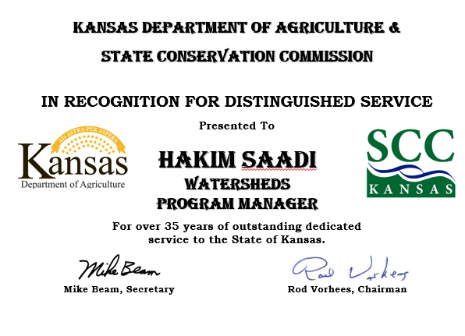

Slide 10
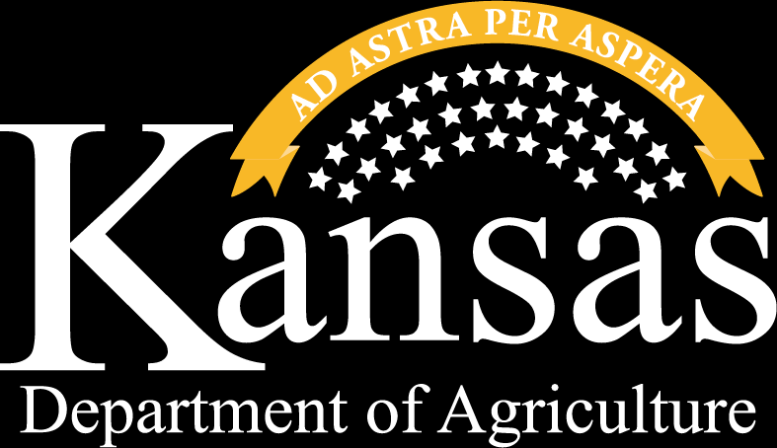
THANK YOU
ANDREW LYON
Andrew.Lyon@ks.gov
Director of Conservation
Kansas Department of Agriculture
Division of Conservation

