Slide 1
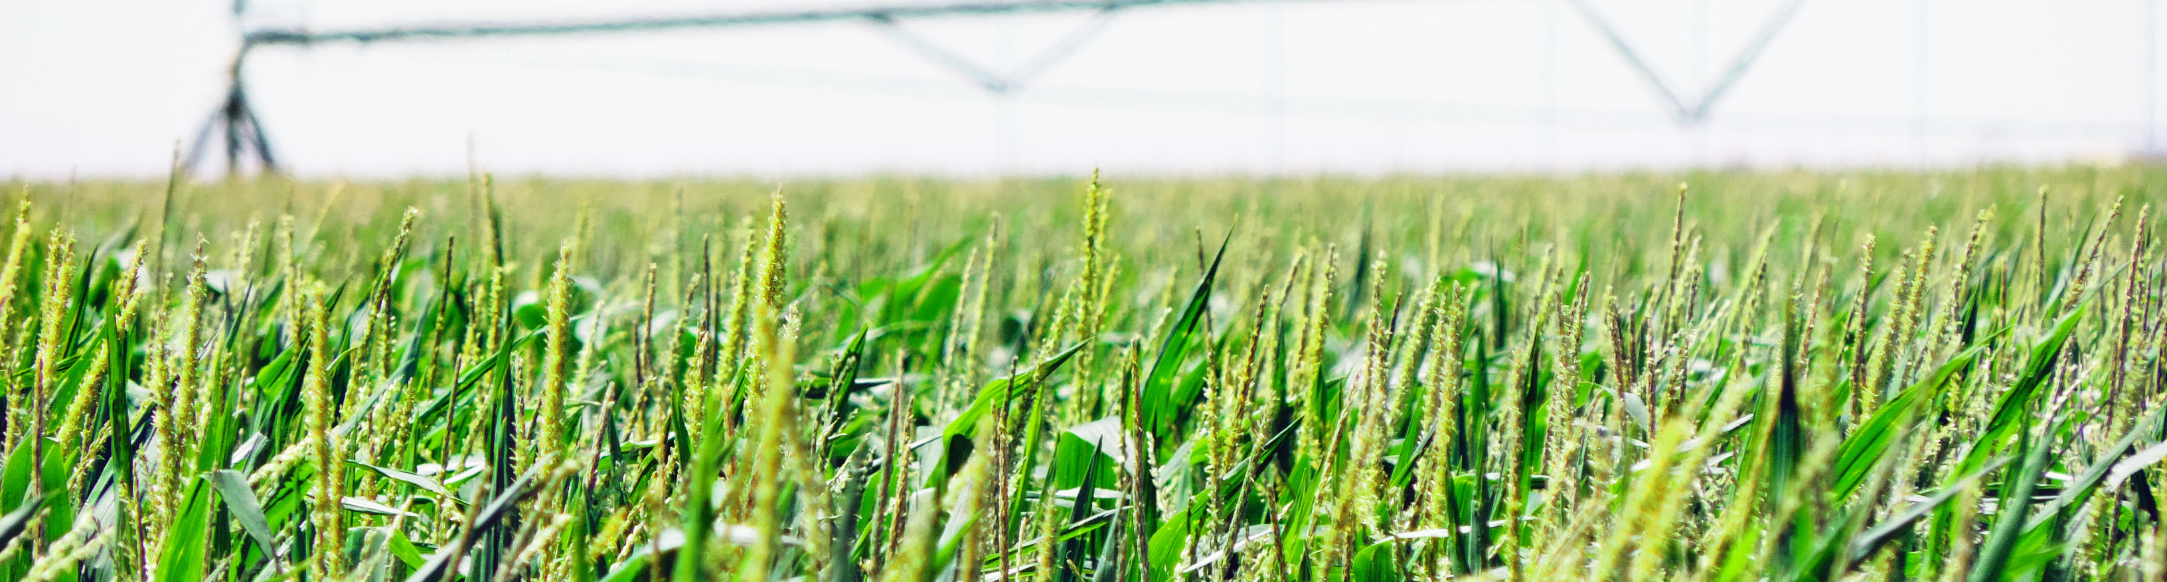
THE KANSAS DEPARTMENT OF AGRICULTURE
Division of Water Resources
January 31, 2023

Slide 2
KDA – Division of Water Resources
Information from Kansas State University Weather Data Library

Slide 3
KDA – Division of Water Resources
Information from Kansas State University Weather Data Library

Slide 4
KDA – Division of Water Resources
Over Pumping – Using more than authorized by water right in a given year
Penalty Category | Severity Level A < 24 Hours Over | Severity Level B 24-72 Hours Over | Severity Level C > 72 Hours Over
1 (no prior offense) | Written notice of noncompliance | $1,000/day and reduction of 2 times over pumped | $1,000/day and reduction of 3 times over pumped
2 (1 prior offense) | $1,000/day and reduction of 2 times over pumped | $1,000/day and one-year suspension | $1,000/day and three-year suspension
3 (2 prior offenses) | $1,000/day and one-year suspension | $1,000/day and three-year suspension | $1,000/day and four-year suspension
4 (>2 prior offenses) | $1,000/day and three-year suspension | $1,000/day and four-year suspension | $1,000/day and five-year suspension
2021 water use year
147 Over pump orders issued
2,720 acre-feet over authorized total
$463,750 fine collected

Slide 5
KDA – Division of Water Resources

Slide 6
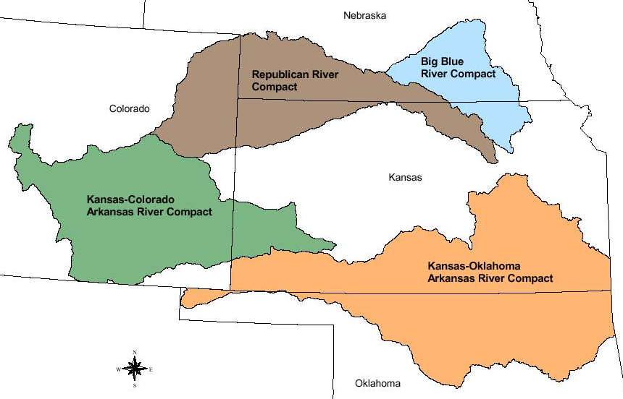
KDA – Division of Water Resources
Interstate Water Compacts
Compliance with all compacts and historically good relationships with our neighboring states.
Meeting regularly with Colorado and Nebraska on Republican River compact issues.
Working with Colorado on Arkansas River water quality.

Slide 7
KDA – Division of Water Resources
Hot Topics
Wichita Aquifer Storage and Recovery Permits
District court case
Hays – R9 Transfer
Kansas Supreme Court
Water Transfer Panel
Rattlesnake Creek/Quivira

Slide 8
KDA – Division of Water Resources
2022 Legislative Additions Dam Safety
3 additional engineering positions
$50,000 Dam Safety Emergency Fund
$150,000 for Dam Safety Program Review

Slide 9
KDA – Division of Water Resources
Dam Safety Program Evaluation
Statutory and regulatory framework compared to other states
Risk based decision making in inspections
Frequency and requirements of safety inspections
PE license requirement for inspection
Need to regulate all SHP and HHP dams
Need to regulate LHP dams

Slide 10
KDA – Division of Water Resources
Dam Safety Program Evaluation
Assignment of risk among dam owners and downstream landowners
Zoning requirements or upgrade responsibility
Other states approaches
Evaluation of Watershed District Act
Are all statutory requirements being met
Is there enough public accountability
Evaluation of DWR and DOC watershed district responsibilities
Distribution of duties and improving efficiency
Evaluation of effectiveness of emergency action plans (EAPs)
Improving templates for rural areas

Slide 11
THANK YOU
DWR Dam Safety Conference
March 16, 2023
Washburn University
Registration Closes Soon
Agriculture.ks.gov

